Slide 1
Data Flow Testing
Dr. Durga Prasad Mohapatra
Professor
CSE Department
NIT Rourkela

Slide 2
Introduction
In path coverage, the emphasis was to cover a path using statement or branch coverage.
However, data and data integrity are as important as code and code integrity of a module.
We have checked every possibility of the control flow of a module. But what about the data flow in the module?
These questions can be answered,, if we consider data objects in the control flow of a module.

Slide 3
Introduction cont…
Data flow testing is a white-box technique that can be used to detect improper use of data values due to coding errors.
Errors may be unintentionally introduced in a program by programmers,
e.g. a programmer might use a variable without defining it.
Data flow testing gives a chance to look out for
inappropriate data definition, their use in predicate, computations, and termination.

Slide 4
Introduction cont…
It identifies the potential bugs
by examining the patterns in which that piece of data is used.
Example: If an out-of-scope data is being used in a computation, then it is a bug. There may be several patterns like this which indicate data anomalies.

Slide 5
Introduction cont…
To examine the patterns, the control flow graph of a program is used.
This test strategy selects the paths in the module’s control flow such that various sequences of data objects can be chosen.
The major focus is on the points at which the data receives values and the places at which the data initialized has been referenced.
Thus, we have to choose enough paths in the control flow to ensure that every data is initialized before use and all the defined data have been used somewhere.

Slide 6
Data Flow-Based Testing
Selects test paths of a program:
According to the locations of
Definitions and Uses of different variables in a program.

Slide 7
Example
1 X(){
int a=5; /* Defines variable a */
….
3 While(c>5) {
4 if (d<50)
b=a*a; /*Uses variable a */
a=a-1; /* Defines variable a */
…
7 }
8 print(a); } /*Uses variable a */

Slide 8
Data Flow-Based Testing cont …
For a statement numbered S,
DEF(S) = {X / statement S contains a definition of X}
USES(S)= {X / statement S contains a use of X}
Example: 1: a=b; DEF(1)={a}, USES(1)={b}.
Example: 2: a=a+b; DEF(1)={a}, USES(1)={a,b}.

Slide 9
Data Flow-Based Testing cont …
A variable X is said to be live at statement S1, if
X is defined at a statement S, and
there exists a path from S to S1 not containing any definition of X.

Slide 10
DU Chain Example
1 X(){
2 int a=5; /* Defines variable a */
3 While(c>5) {
4 if (d<50)
5 b=a*a; /*Uses variable a */
6 a=a-1; /* Defines variable a */
7 }
8 print(a); } /*Uses variable a */

Slide 11
Definition-use chain (DU chain)
[X,S,S1],
S and S1 are statement numbers,
X ∈ DEF(S),
X ∈ USES(S1), and
the definition of X in the statement S is live at statement S1.

Slide 12
Data Flow-Based Testing Strategy
One simple data flow testing strategy:
Every DU chain in a program be covered at least once.
Data flow testing strategies:
Useful for selecting test paths of a program containing nested if and loop statements.

Slide 13
Example
1 X(){
2 B1; /* Defines variable a */
3 While(C1) {
4 if (C2)
5 if(C4) B4; /*Uses variable a */
6 else B5;
7 else if (C3) B2;
8 else B3; }
9 B6 }

Slide 14
Example cont …
[a,1,5]: a DU chain.
Assume:
DEF(X) = {B1, B2, B3, B4, B5}
USES(X) = {B2, B3, B4, B5, B6}
There are 25 DU chains.
However only 5 paths are needed to cover these chains.

Slide 15
Data Flow Testing cont…
It also closely examines the state of the data in the CFG resulting in a richer test suite
than the one obtained from CFG based path testing strategies like statement coverage, branch coverage, etc.

Slide 16
States of a Data Object
Defined (d):
Killed / Undefined / Released (k):
Usage (u):
Computational use (c-use) or
Predicate use (p-use).

Slide 17
State of a Data Object cont …
A data object can be in the following states:
Defined (d) A data object is called defined when it is initialized, i.e., when it is on the left side of an assignment statement. Defined state can also be used to mean that a file has been opened, a dynamically allocated object has been allocated, something is pushed onto the stack, a record written, and so on.

Slide 18
State of a Data Object cont…
Kill/Undefined/Released (k)
When the data has been reinitialized or the scope of a loop control variable finishes, i.e., exiting the loop or memory is released dynamically or a file has been closed.

Slide 19
State of a Data Object cont…
Usage (u) When the data object is on the right side of assignment or the control variable in a loop, or in an expression used to evaluate the control flow of a case statement, or as a pointer to an object, etc.
In general, we say that the usage is either computational use (c-use) or predicate use (p-use).

Slide 20
Data-Flow Anomalies
Data-flow anomalies represent the patterns of data usage which may lead to an incorrect execution of the code.
An anomaly is denoted by a two-character sequence of actions.

Slide 21
Data-Flow Anomalies cont…
Example: ‘dk’ means a variable is defined and killed without any use, which is a potential bug.
There are nine possible two-character combinations out of which only four are data anomalies, as shown in next Table.

Slide 22
Table 1: Two-character data-flow anomalies
Anomaly | Explanation | Effect of Anomaly
du | Define-use | Allowed, Normal case.
dk | Define-Kill | Potential bug. Data is killed without use after definition.
ud | Use-define | Data is used and then redefine. Allowed, Usually not a bug because the language permits reassignment at almost any time.
uk | Use-Kill | Allowed, Normal situation.
ku | Kill-use | Serious bug because the data is used after being killed.
kd | Kill-define | Data is Killed and then redefined, Allowed
dd | Define-define | Redefining a variable without using it . Harmless bug, but not allowed.
uu | Use-use | Allowed Normal case.
kk | Kill-kill | Harmless bug, but not allowed.

Slide 23
Not all data-flow anomalies are harmful, but most of them are suspicious and indicate that an error can occur.
There may be single-character data anomalies also.
To represent these types of anomalies, we take the following conventions:
~x: indicates all prior actions are not of interest to x.
x~: indicates all post actions are not listed of interest to x.

Slide 24
Table 2: Single-character data-flow anomalies
Anomaly | explanation | Effect of Anomaly
~d | First definition | Normal situation, Allowed.
~u | First Use | Data is used without defining it. Potential bug.
~k | First Kill | Data is killed before defining it, Potential bug.
D~ | Define last | Potential bug.
U~ | Use last | Normal case, Allowed.
K~ | Kill last | Normal case, Allowed.

Slide 25
Some Terminologies
Suppose P is a program that has a graph G (P) and a set of variables V. The graph has a single entry and exit node.
Definition node Defining a variable means assigning value to a variable for the very first time in a program. For example, input statements, assignment statements, loop control statements, procedure calls, etc.

Slide 26
Some Terminologies contd…
Usage node It means the variable has been used in some statement of the program. Node n that belongs to G(p) is usage node of variable v, if the value of variable v is used at the statements corresponding to node n.

Slide 27
Some Terminologies contd…
A usage node can be of the following two types:
Predicate usage Node: If usage node n is a predicate node, then n is a predicate usage node.
Computation Usage Node: If usage node n corresponds to a computation statement in a program other than predicate, then it is called a computation usage node.

Slide 28
Some Terminologies contd…
Loop-free path segment It is a path segment for which every node is visited once at most.
Simple path segment It is a path segment in which at most one node is visited twice. A simple path segment is either loop-free or if there is a loop, only one node is involved.
Definition-use path (du-path) A du-path with respect to a variable v is a path between the definition node and usage node of that variable, Usage node can either be a p-usage or a c-usage node.

Slide 29
Some Terminologies contd…
Definition-clear path (dc-path) A dc-path with respect to a variable v is a path between the definition node and the usage node such that no other node in the path is a defining node of variable v.
The du paths which are not dc paths are important, as these are potential spots for testing persons.
Those du-paths which are definition-clear are easy to test in comparison to du-paths which are not dc-paths.
The du-paths which are not dc-paths need more attention.

Slide 30
Static Data Flow Testing
With static analysis, the source code is analysed without executing it.
EXAMPLE:
Consider a program for calculating the gross salary of an employee in an organization. If his basic salary < 1500, then HRA=10% of the Basic and DA=90% of basic. If his salary >= 1500, then HRA=500 and DA=98% of basic. Calculate the gross salary.

Slide 31
main()
{
float bs, gs, da, hra=0;
printf(“Enter basic salary”);
scanf(“%f”,&bs);
if(bs < 1500)
{
hra=bs * 10/100;
da= bs * 90/100;
}
else
{
hra = 500;
da= bs * 98/100;
}
gs= bs+ hra+ da;
printf(“Gross Salary = Rs. %f”, gs);
}
Find out the define-use-kill patterns for all the variables in the program

Slide 32
Solution
Pattern | Line Number | Explanation
~d | 3 | Normal case. Allowed
du | 3-4 | Normal case. Allowed
uu | 4-6,6-7,7-12,12-14 | Normal case. Allowed
uk | 14-16 | Normal case. Allowed
K~ | 16 | Normal case. Allowed
Define-use-kill patterns for variable ‘bs’

Slide 33
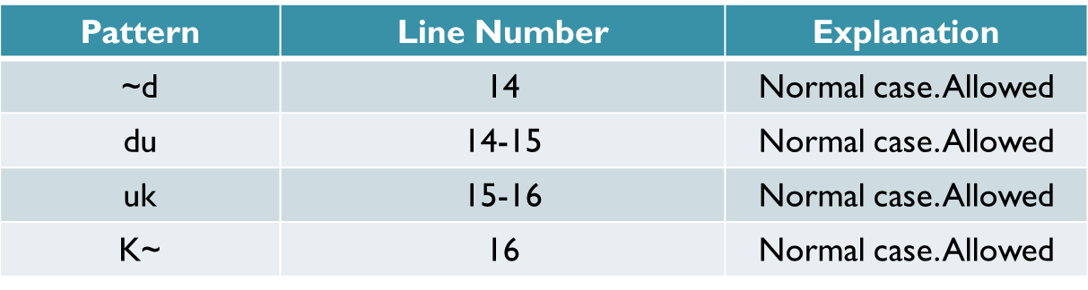
Solution cont…
Define-use-kill patterns for variable ‘gs’

Slide 34
Solution cont…
Pattern | Line Number | Explanation
~d | 7 | Normal case. Allowed
du | 7-14 | Normal case. Allowed
uk | 14-16 | Normal case. Allowed
K~ | 16 | Normal case. Allowed
Define-use-kill patterns for variable ‘da’

Slide 35
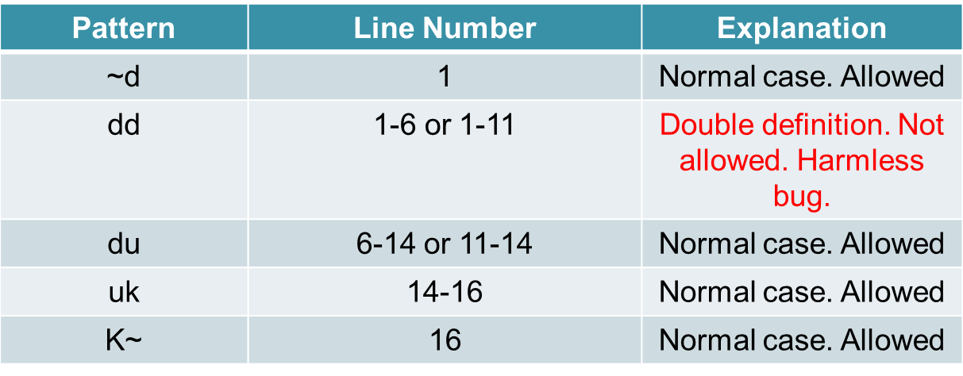
Solution cont…
Define-use-kill patterns for variable ‘hra’
From the above static data flow testing, only one bug is found, i.e in variable HRA
of double definition.

Slide 36
Summary
Discussed the basic concepts of data flow testing.
Explained DU Chain.
Presented the different states of a data object.
Explained the different data-flow anomalies.
Explained static data flow testing with an example.

Slide 37
References
Rajib Mall, Fundamentals of Software Engineering, (Chapter – 10), Fifth Edition, PHI Learning Pvt. Ltd., 2018.
Naresh Chauhan, Software Testing: Principles and Practices, (Chapter – 5), Second Edition, Oxford University Press, 2016.

Slide 38
Thank you

